Slide 1
Informed search algorithms

Slide 2
Outline
Best-first search
A* search
Heuristics
Local search algorithms
Hill-climbing search
Simulated annealing search
Local beam search

Slide 3
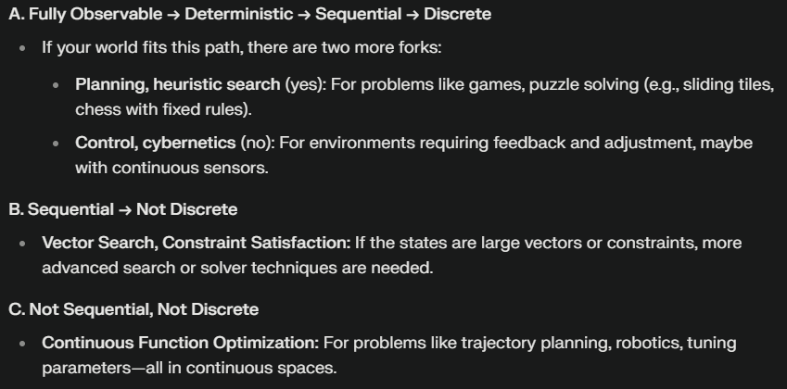
Environment Type Discussed In this Lecture
Fully Observable
Static Environment
yes
Deterministic
yes
Sequential
yes
no
Discrete
no
yes
Discrete
no
yes
Planning, heuristic search
Control, cybernetics
Vector Search: Constraint Satisfaction
Continuous Function Optimization
CMPT 310 - Blind Search

Slide 4
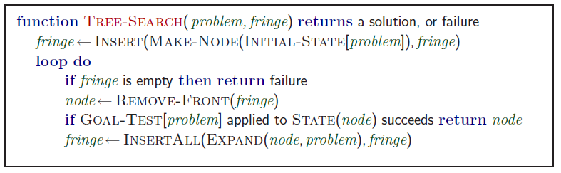
Review: Tree search
A search strategy is defined by picking the order of node expansion
Which nodes to check first?

Slide 5
Knowledge and Heuristics
Simon and Newell, Human Problem Solving, 1972.
Thinking out loud: experts have strong opinions like “this looks promising”, “no way this is going to work”.
S&N: intelligence comes from heuristics that help find promising states fast.

Slide 6
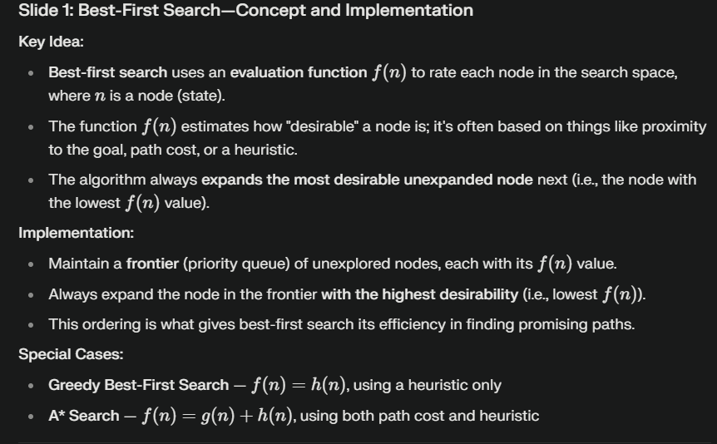
Best-first search
Idea: use an evaluation function f(n) for each node
  estimate of "desirability"
  Expand most desirable unexpanded node
Implementation:
Order the nodes in frontier in decreasing order of desirability
Special cases:
  greedy best-first search
  A* search

Slide 7

Romania with step costs in km

Slide 8
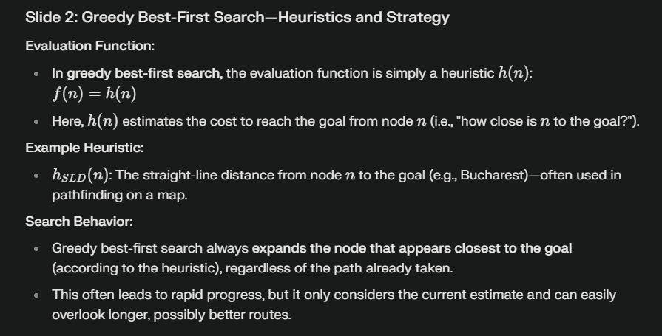
Greedy best-first search
Evaluation function
  f(n) = h(n) (heuristic)
  = estimate of cost from n to goal
e.g., h_{SLD}(n) = straight-line distance from n to Bucharest
Greedy best-first search expands the node that appears to be closest to goal

Slide 9

Greedy best-first search example

Slide 10

Greedy best-first search example

Slide 11

Greedy best-first search example

Slide 12

Greedy best-first search example
http://aispace.org/search/

Slide 13
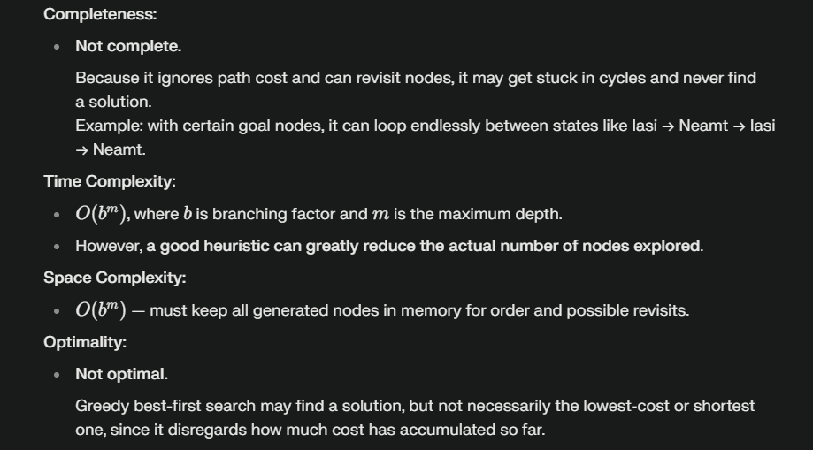
Properties of greedy best-first search
Complete? No – can get stuck in loops,
  e.g. as Oradea as goal
    Iasi → Neamt → Iasi → Neamt →
Time? O(b^{m}), but a good heuristic can give dramatic improvement
Space? O(b^{m}) -- keeps all nodes in memory
Optimal? No

Slide 14
A* search
Idea: avoid expanding paths that are already expensive.
Very important!
Evaluation function f(n) = g(n) + h(n)
h(n) = estimated cost from n to goal
f(n) = estimated total cost of path through n to goal
g(n) = cost so far to reach n

Slide 15

A* search example

Slide 16

A* search example

Slide 17

A* search example

Slide 18

A* search example

Slide 19

A* search example

Slide 20

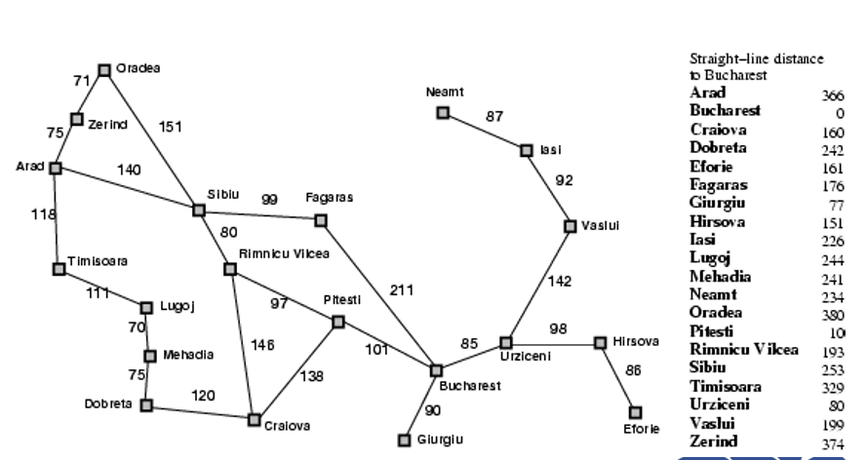
A* search example
http://aispace.org/search/
We stop when the node with the lowest f-value is a goal state.
Is this guaranteed to find the shortest path?

Slide 21
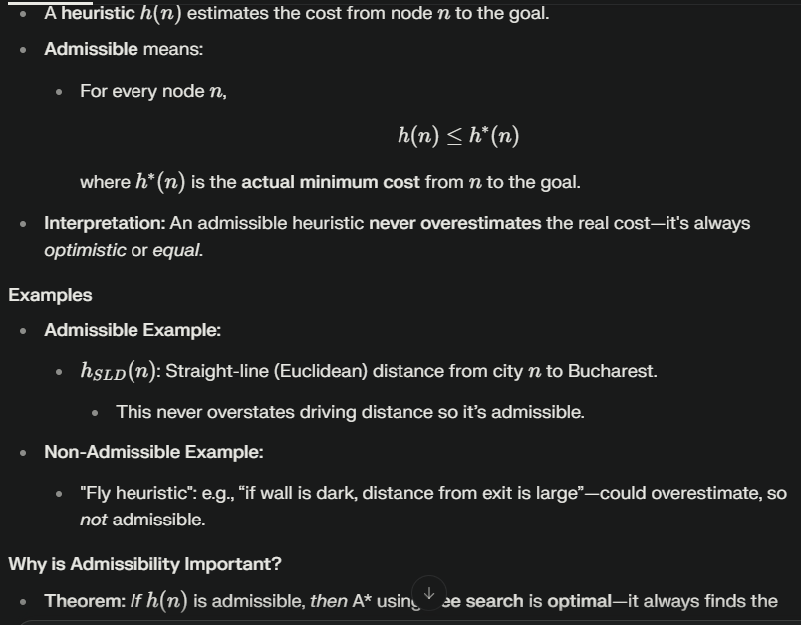
Admissible heuristics
A heuristic h(n) is admissible if for every node n,
h(n) ≤ h*(n), where h*(n) is the true cost to reach the goal state from n.
An admissible heuristic never overestimates the cost to reach the goal, i.e., it is optimistic.
Example: h_{SLD}(n) (never overestimates the actual road distance)
Negative Example: Fly heuristic: if wall is dark, then distance from exit is large.
Theorem: If h(n) is admissible, A* using TREE-SEARCH is optimal
Suppose, after running A*, a suboptimal solution G2G2 is in the search frontier (not yet chosen but available to be expanded).
At the same time, there is an unexpanded node nn that lies on the real shortest path to the best solution GG.
Goal: Show A* will not expand G2G2 before it expands nn, thus will find the optimal goal GG first.
How the Proof Works
f-values:
  For any goal node, h=0h=0 (because from goal to goal is distance 0).
  Therefore,
  f(G2)=g(G2)+h(G2)=g(G2)f(G2)=g(G2)+h(G2)=g(G2)and
  f(G)=g(G)f(G)=g(G)
G22 is suboptimal:
g(G2)>g(G)g(G2)>g(G), so f(G2)>f(G)f(G2)>f(G).
For node nn on the optimal path:
  h(n)≤h∗(n)h(n)≤h∗(n) since heuristic is admissible.
  f(n)=g(n)+h(n)≤g(n)+h∗(n)f(n)=g(n)+h(n)≤g(n)+h∗(n).
  g(n)+h∗(n)g(n)+h∗(n) is just the cost of an optimal path through nn to the goal—so it is ≤g(G)≤g(G), hence f(n)≤f(G)f(n)≤f(G).
Ordering:
  So: f(G2)>f(G)≥f(n)f(G2)>f(G)≥f(n).
  Therefore, A* will always choose and expand nn (or some other node with lower or equal ff) before ever expanding G2G2, i.e., before ever expanding a suboptimal goal.
Conclusion:
A* search always finds the optimal (shortest/lowest cost) path first, if the heuristic is admissible.

Slide 22

Optimality of A* (proof)
Suppose some suboptimal goal path G₂ has been generated and is in the frontier. Let n be an unexpanded node in the frontier such that n is on a shortest path to an optimal goal G.
f(G₂) = g(G₂) since h(G₂) = 0 because h is admissible
g(G₂) > g(G) since G₂ is suboptimal, cost of reaching G is less.
f(G) = g(G) since h(G) = 0
f(G₂) > f(G) from above

Slide 23
Optimality of A* (proof)
Suppose some suboptimal goal path G₂ has been generated and is in the frontier. Let n be an unexpanded node in the frontier such that n is on a shortest path to an optimal goal G.
f(G₂) > f(G) from above
h(n) ≤ h*(n) since h is admissible, h* is minimal distance.
g(n) + h(n) ≤ g(n) + h*(n)
f(n) ≤ f(G)
Hence f(G₂) > f(n), and A* will never select G₂ for expansion

Slide 24

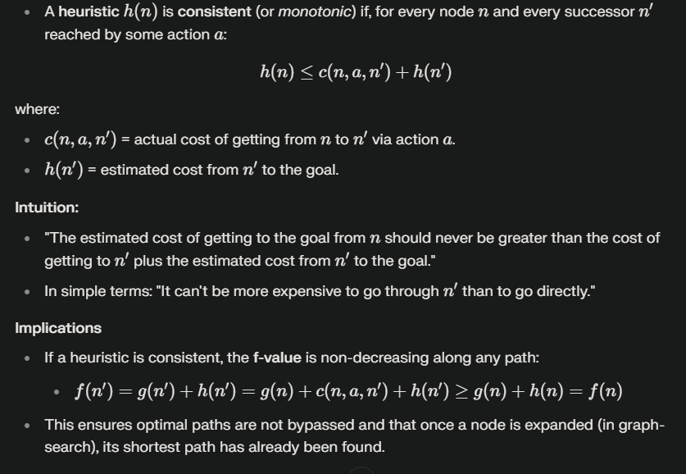
Consistent heuristics
A heuristic is consistent if for every node n, every successor n' of n generated by any action a,
h(n) ≤ c(n,a,n') + h(n')
Intuition: can’t do worse than going through n’.
If h is consistent, we have
f(n') = g(n') + h(n') = g(n) + c(n,a,n') + h(n')
≥ g(n) + h(n) = f(n)
i.e., f(n) is non-decreasing along any path.
Theorem: If h(n) is consistent, A* using GRAPH-SEARCH is optimal
If h(n)h(n) is consistent, then A* using graph search is guaranteed to be optimal.

Slide 25
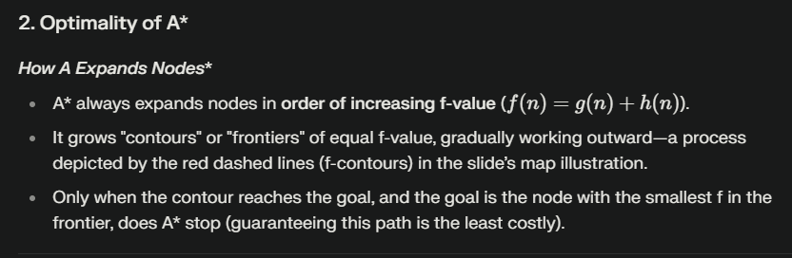

Optimality of A*
A* expands nodes in order of increasing f value
http://aispace.org/search/
Gradually adds "f-contours" of nodes
Contour i has all nodes with f=f_{i}, where f_{i} < f_{i+1}

Slide 26
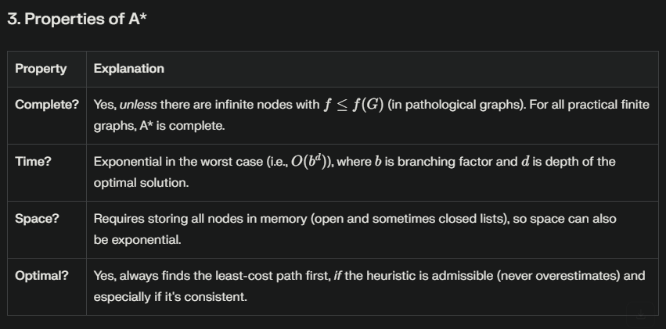
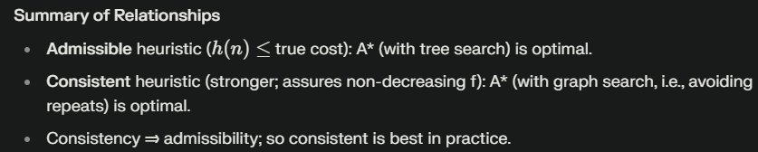
Properties of A*
Complete? Yes (unless there are infinitely many nodes with f ≤ f(G) )
Time? Exponential
Space? Keeps all nodes in memory
Optimal? Yes
Also optimally efficient: any search based on h must expand as many nodes as A*. Reason: think of f(n) as saying: this path could lead to the goal as quickly as f(n). So must try it.

Slide 27

Admissible heuristics
E.g., for the 8-puzzle:
h₁(n) = number of misplaced tiles
h₂(n) = total Manhattan distance
(i.e., no. of squares from desired location of each tile)
h₁(S) = ?
h₂(S) = ?

Slide 28
Admissible heuristics
E.g., for the 8-puzzle:
h₁(n) = number of misplaced tiles
h₂(n) = total Manhattan distance
(i.e., no. of squares from desired location of each tile)
h₁(S) = ? 8
h₂(S) = ? 3+1+2+2+2+3+3+2 = 18

Slide 29
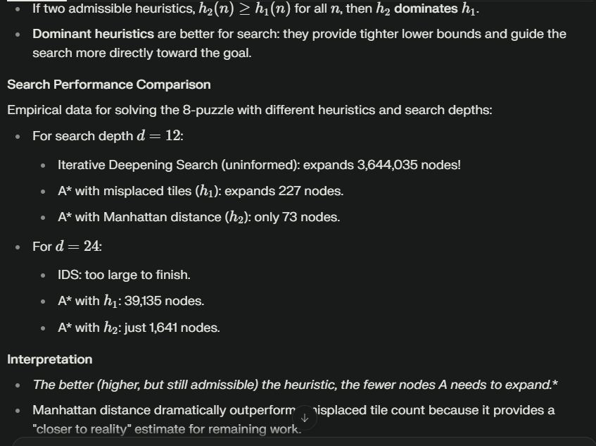
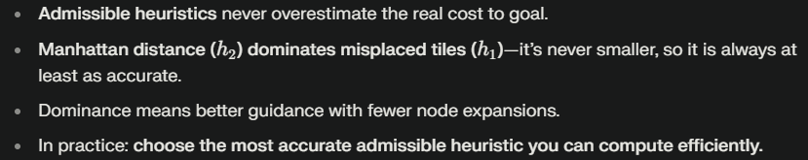
Dominance
If h₂(n) ≥ h₁(n) for all n (both admissible) then h₂ dominates h₁ .
h₂ is better for search
Typical search costs (average number of nodes expanded):
d=12 IDS = 3,644,035 nodes
A*(h₁) = 227 nodes
A*(h₂) = 73 nodes
d=24 IDS = too many nodes
A*(h₁) = 39,135 nodes
A*(h₂) = 1,641 nodes

Slide 30
Relaxed problems
A problem with fewer restrictions on the actions is called a relaxed problem
The cost of an optimal solution to a relaxed problem is an admissible heuristic for the original problem
If the rules of the 8-puzzle are relaxed so that a tile can move anywhere, then h₁(n) gives the shortest solution
If the rules are relaxed so that a tile can move to any adjacent square, then h₂(n) gives the shortest solution

Slide 31
Admissible Heuristic Examples
Toy Problem | Example Goal | Heuristic(s) | Admissible?
Vacuum Cleaner Problem | Clean all rooms | 1. Number of dirty rooms2. Steps to reach each dirty room | 1: ✅2: ✅
Maze Navigation | Reach exit from a given start location | 1. Manhattan distance2. Euclidean distance3. Number of turns | 1: ✅2: ✅3: ❌
Rubik’s Cube | Achieve solved cube state | 1. Number of misplaced pieces2. Pattern database heuristic | 1: ✅2: ✅
Sudoku Solver | Fill all cells satisfying constraints | 1. Number of empty cells2. Number of constraint violations | 1: ✅2: ❌
Blocks World | Reach desired block stack configuration | 1. Number of misplaced blocks 2. Sum of block movements needed | 1: ✅2: ✅
Robot Navigation | Reach a destination while avoiding obstacles | 1. Manhattan or Euclidean distance2. Grid-based cost map | 1: ✅2: ❌ (if it overestimates due to weights)

Slide 32
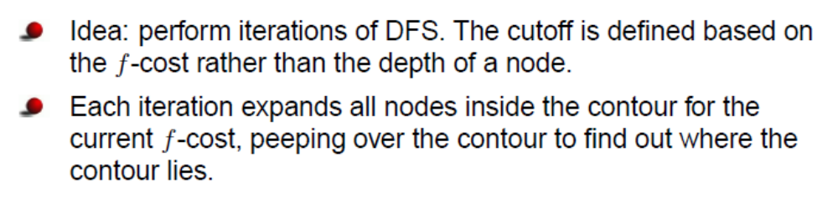
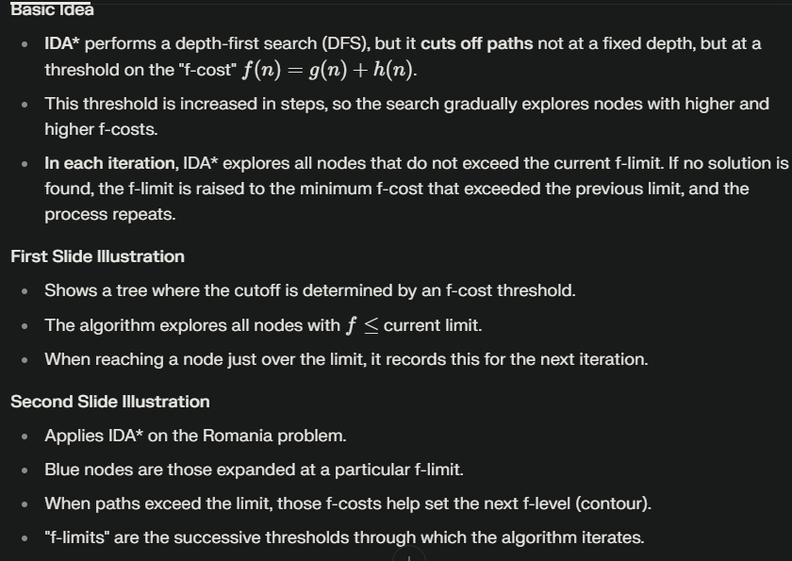
Iterative Deepening A* (IDA*)

Slide 33
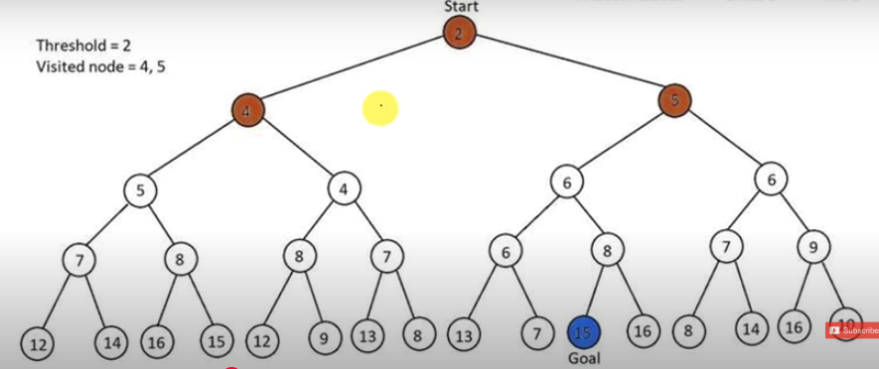
Example IDA*

Slide 34
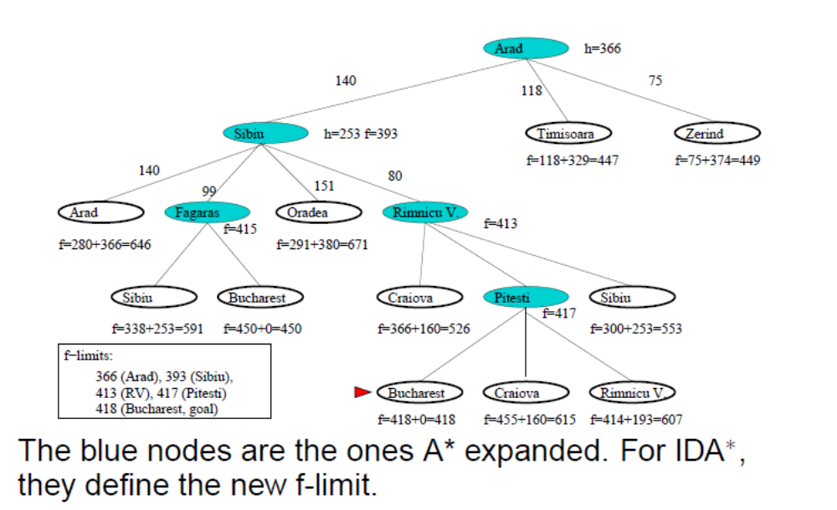
Iterative Deepening A* (IDA*)

Slide 35
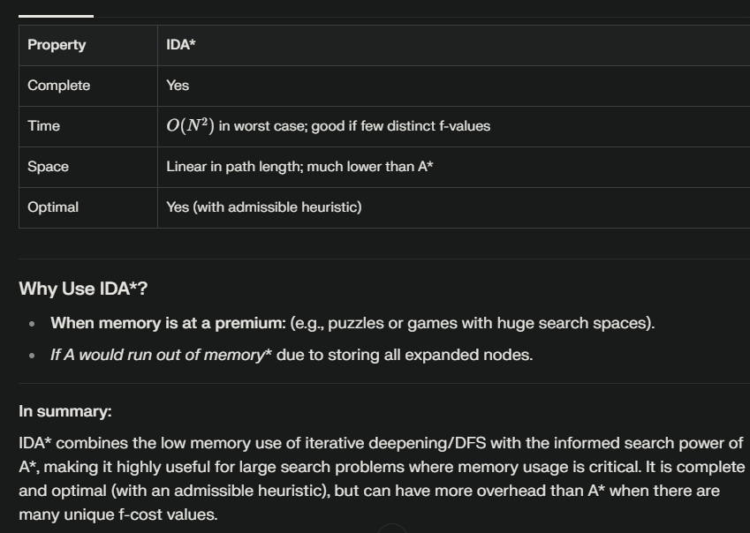
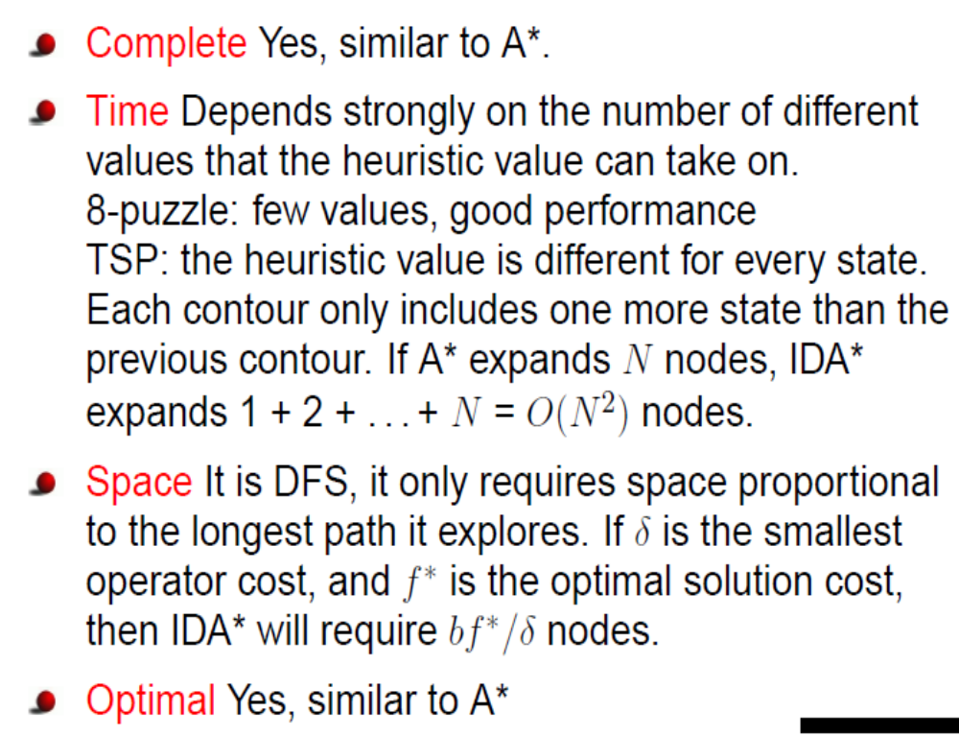

Properties of IDA*

Slide 36
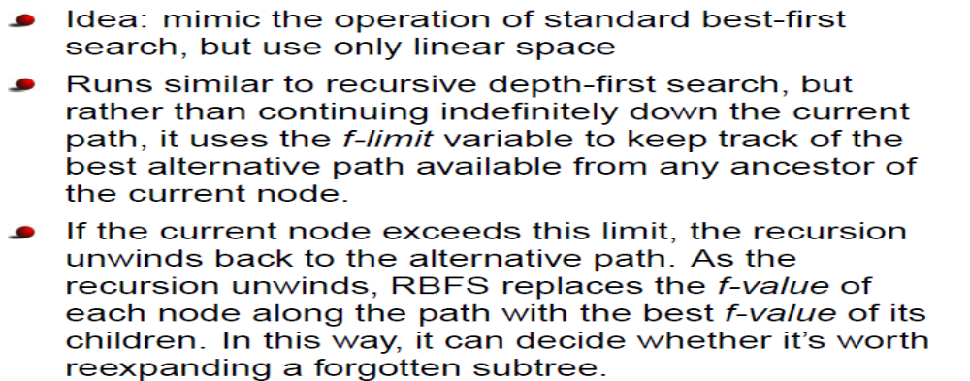
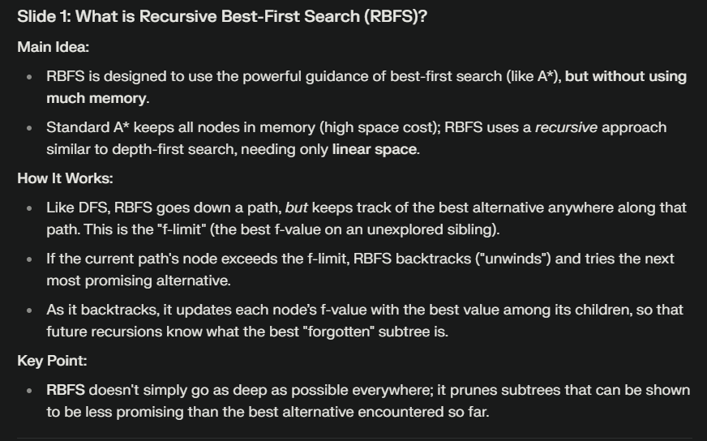
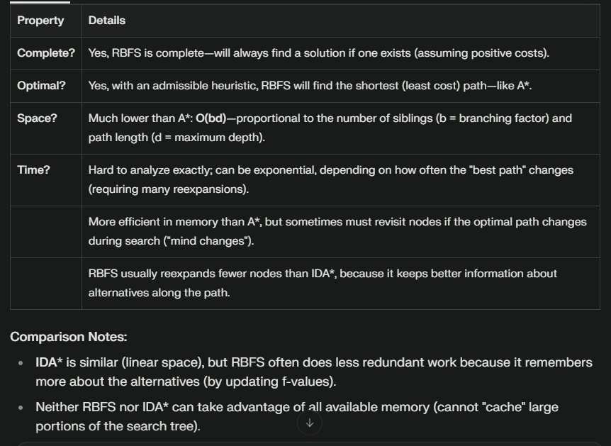
Recursive Best First Search (RBFS)

Slide 37
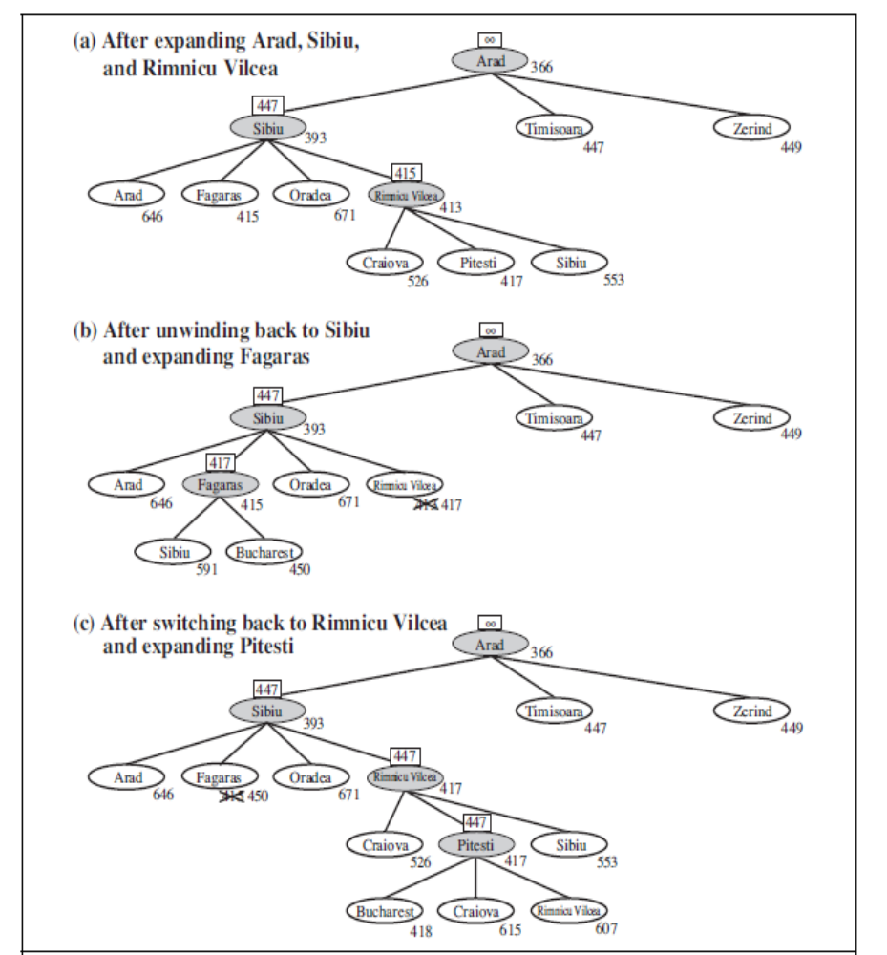
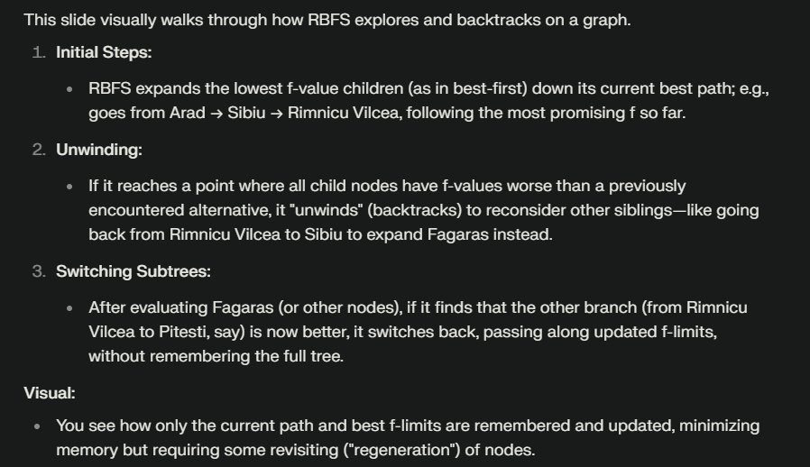
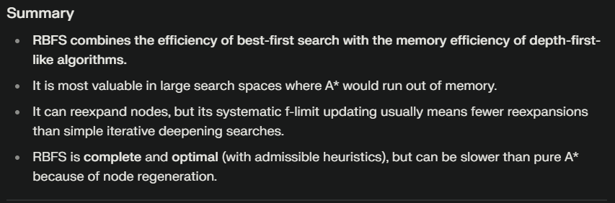
Recursive Best First Search (RBFS)

Slide 38
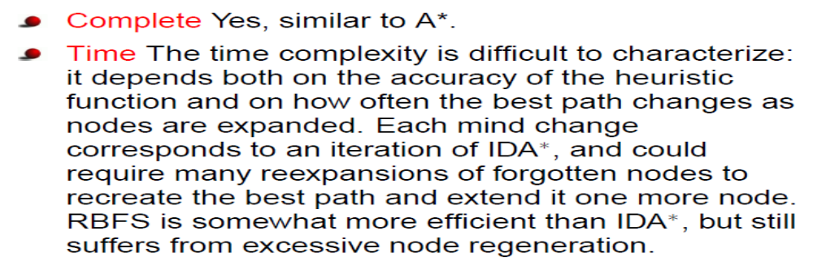
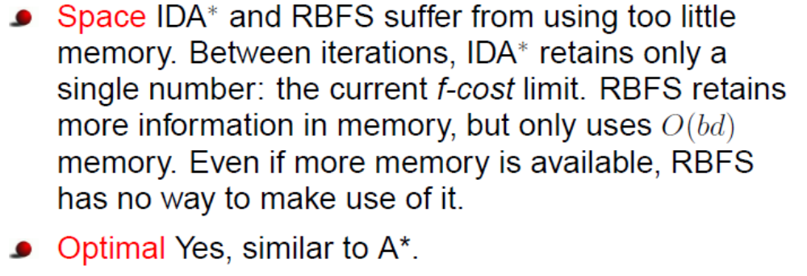
Properties of RBFS

Slide 39
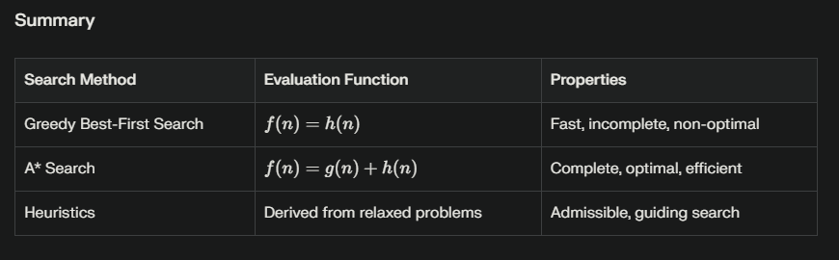
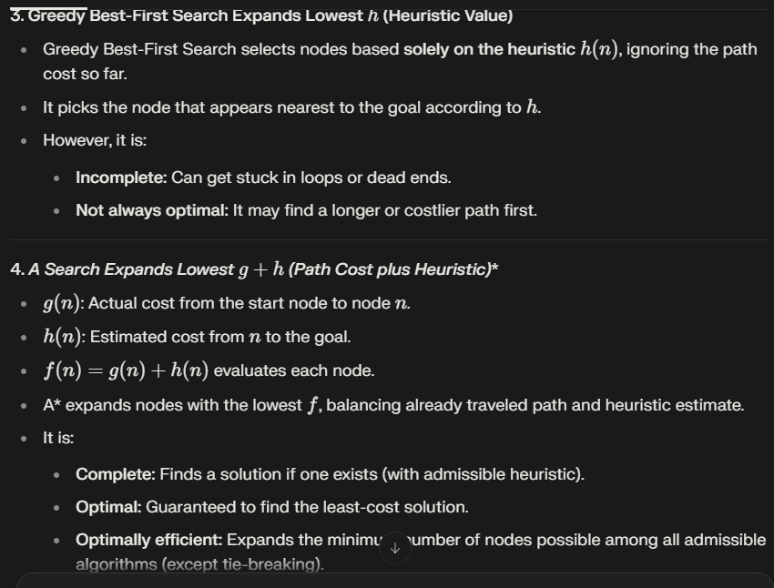
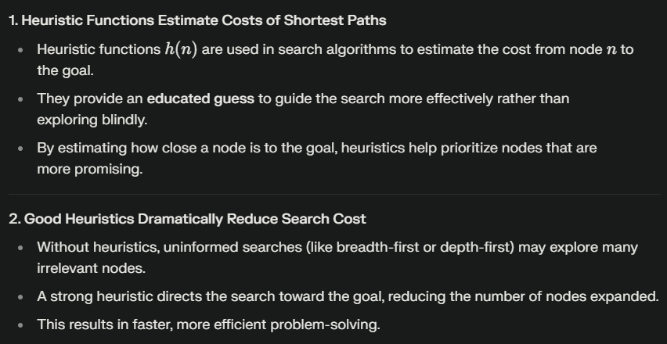
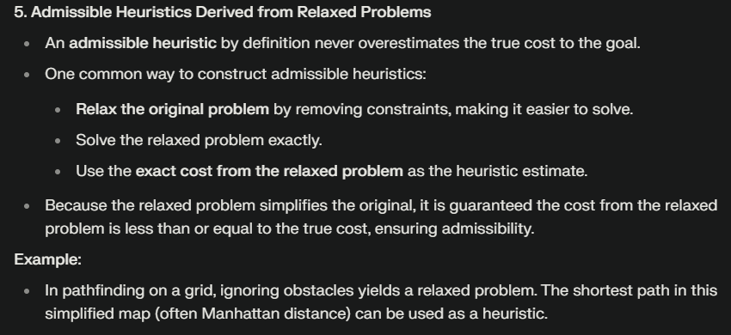
Summary
Heuristic functions estimate costs of shortest paths
Good heuristics can dramatically reduce search cost
Greedy best-first search expands lowest h
  incomplete and not always optimal
A∗ search expands lowest g + h
  complete and optimal
  also optimally efficient (up to tie-breaks)
Admissible heuristics can be derived from exact solution of relaxed problems

Slide 40
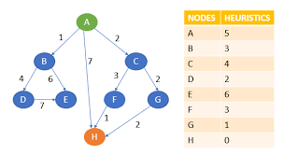
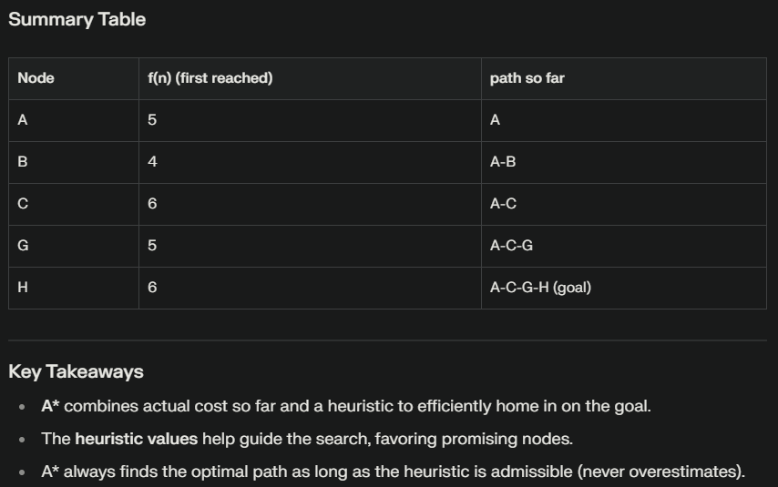
Example

Slide 41
Missionaries and Cannibals
Old puzzle: has been around since 700 AD.
Solved by Computer!
Try it at home!
Good for depth-first search: basically, linear solution path.
Another view of informed search: we use so much domain knowledge and constraints that depth-first search suffices.
The problem graph is larger than the problem statement.
Taking the state graph as input seems problematic.

